Slide 1
Stacks and Queues

Slide 2
Learning Outcomes
LO2.1 Define stack and queue.
LO2.2 List and demonstrate the operations common to stacks and queues.
LO2.3 Describe specific tasks to which stacks and queues are suited.
LO2.4 Apply stacks to a specific application.
LO2.5 Apply queues to a specific application.
LO2.6 Write programs to implement stack and queue in Java programming language.
LO2.7 Define and explain the need of priority queue.

Slide 3
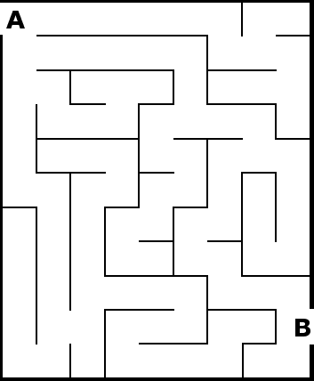
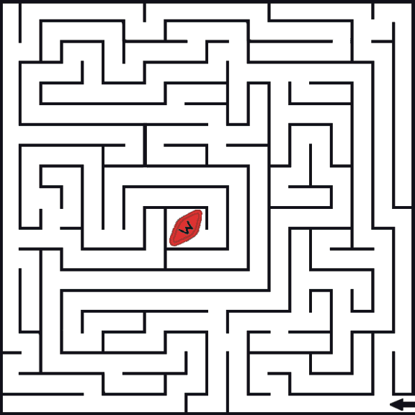
Intro: How to exit a maze
To proceed by trial and error ➔Stack: a way to exit a maze

Slide 4
Objectives
Discuss the following topics:
1- Stacks
2- Queues
3- Priority Queues
Case Study: Exiting a Maze ← In the textbook
They are restricted lists:
Restricting their number of elements and/or
Restricting operations on them
Notes:
Maze: mê cung

Slide 5
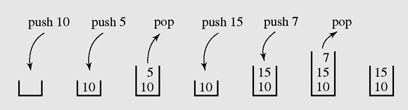
1- Stacks
A stack is a linear data structure that can be accessed only at one of its ends for storing and retrieving data.
A stack is called an LIFO structure: last in/first out
Figure 4-1 A series of operations executed on a stack

Slide 6
1- Stacks…
Where a stack should be used?
Stack should be used when processing order of data is opposed to creating order.
n= 12 : 2
0 6 : 2
0 3 : 2
1 1 : 2
1
base=2
Convert an positive number to a binary string.
1100
1
1
0
0

Slide 7
1- Stacks (continue)
The following operations are needed to properly manage a stack:
clear() — Clear the stack
isEmpty() — Check to see if the stack is empty
push(el) — Put the element el on the top of the stack
pop() — Take the topmost element from the stack
topEl() — Return the topmost element in the stack without removing it

Slide 8
How to Implementation a Stack
Select a linear storage → array/ linked list
Implement all basic operations:
clear() , isEmpty() , push(el) , pop() , topEl()
List | Using array → linear group | Using linked list → linear group
Stack push(x) pop() | Add to end → push(x) → O(1) Remove from end → pop() →O(1) | Add to end → O(1) Remove from end → O(1) OR Add to head → O(1) Remove from head → O(1)

Slide 9
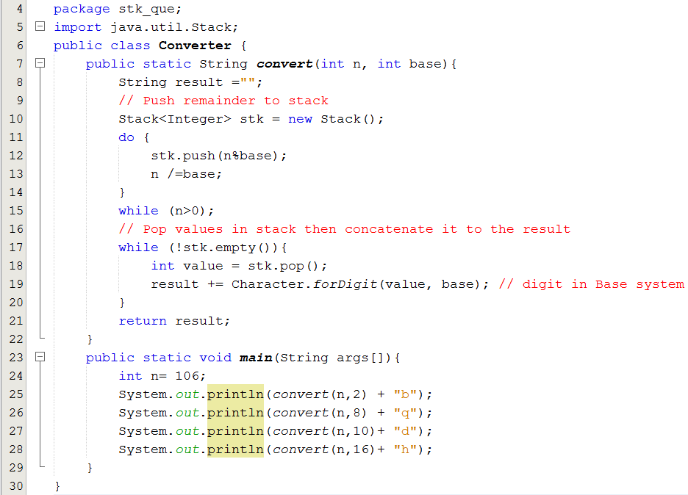
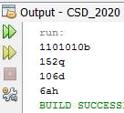
1- Stacks: Demo 1.
Using the java.util.Stack class

Slide 10
1- Stacks (continued)
Matching delimiters- A way to use stacks
a = b + (c – d ) * (e – f);
g[10] = h[i[9]] + (j + k) * l;
while (m < (n[8] + o)) { p = 7; r = 6; }
a = b + (c – d) * (e – f));
g[10] = h[i[9]] + j + k) * l;
while (m < (n[8] + o]) { p = 7; r = 6; }
while (m < (n[8] + o))
Matched
Mismatched
Nested matched
Algorithm for delimiter matching : refer to the page 142.

Slide 11
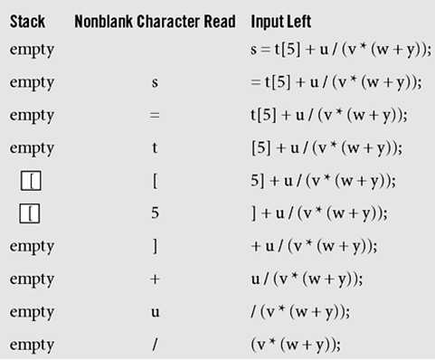
1- Stacks (continued)
Push to the stack an open delimiter and pop it from the stack when appropriate close delemiter is detected in input string
Figure 4-2 Processing the statement s=t[5]+u/(v*(w+y));
with the algorithm delimiterMatching()

Slide 12
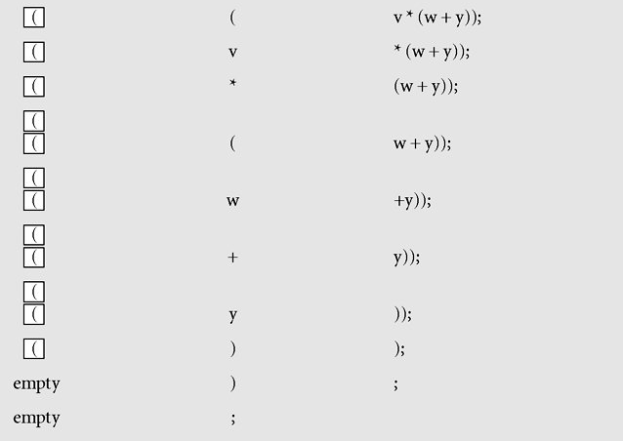
1- Stacks (continued)
Figure 4-2 Processing the statement s=t[5]+u/(v*(w+y));
with the algorithm delimiterMatching()

Slide 13
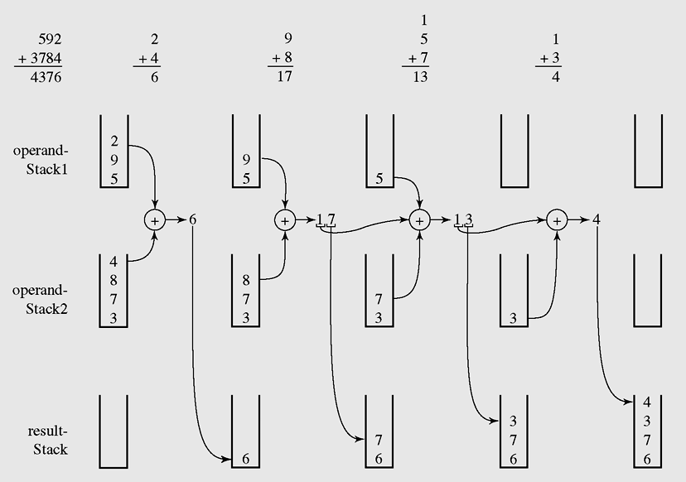
1- Stacks (continued)
Carry=0
Carry=0
Carry=1
Carry=1
Pop all elements in this stack to make the result
An example of adding string numbers “592” and “3784”
using stacks

Slide 14
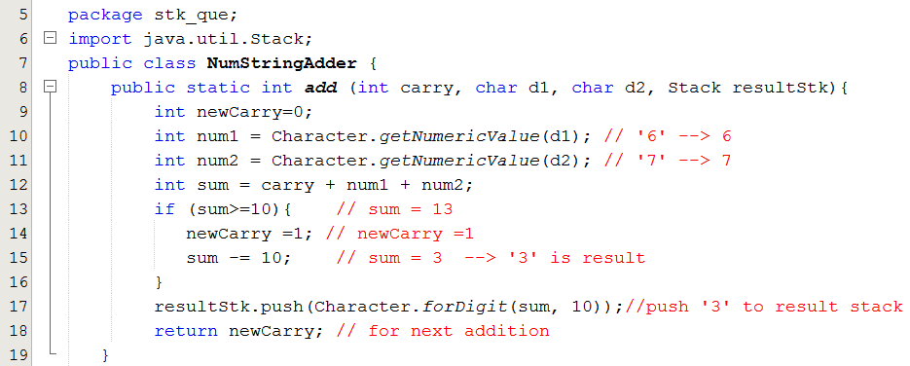
1- Stacks (continued) – Demo 2.
Adding 2 positive integral strings using stacks

Slide 15
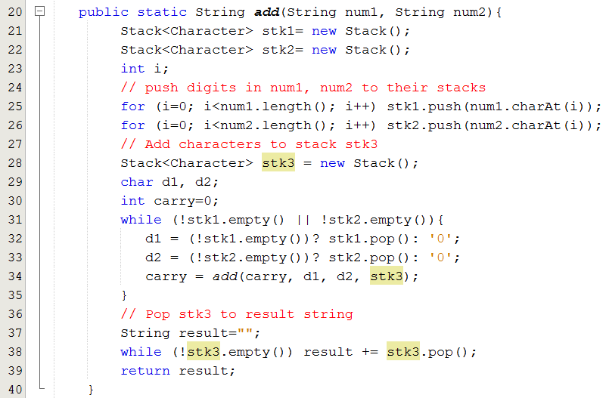
1- Stacks (continued) – Demo 2.

Slide 16
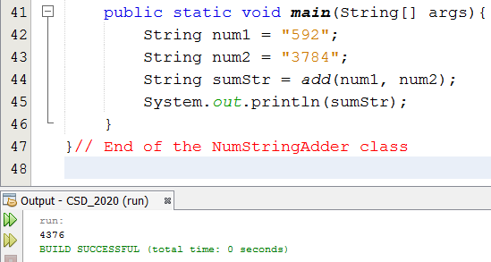
1- Stacks (continued) – Demo 2.

Slide 17
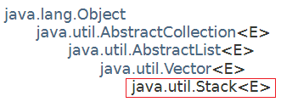
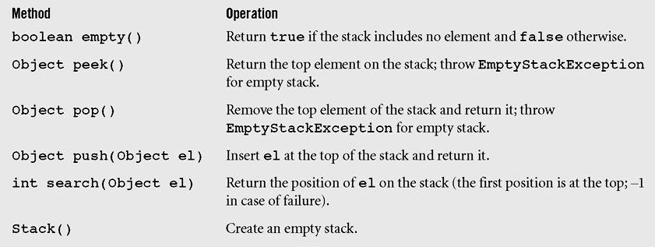
Stacks in java.util
It is a subclass of the Vectior class, a dynamic array.
A list of methods in java.util.Stack; all methods from Vector are inherited

Slide 18
Stacks in java.util
We can create a stack using the java.util.LinkedList with attentions:
Use the method addFirst(x) and remove(), removeFirst() only
OR
Use the method add(x), addLast(x) and removeLast() only

Slide 19
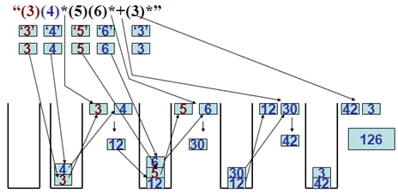
1- Stack: Demo 3.
Evaluating a simple postfix expression using stack.
StringTokenizer:
3
4
*
5
6
*
+
3
*

Slide 20
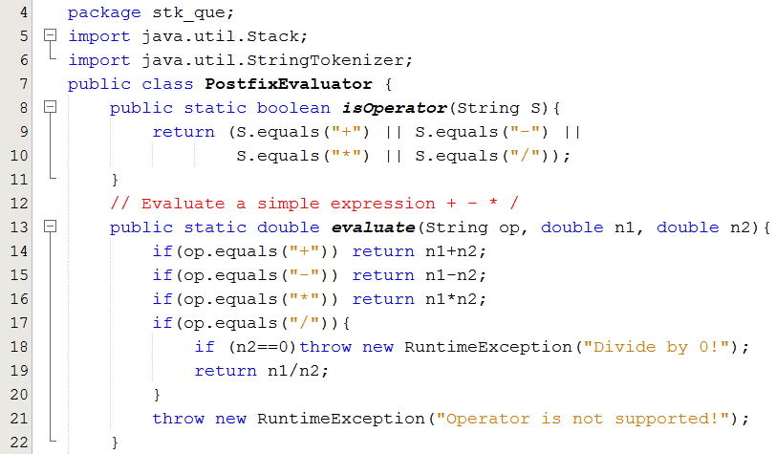
1- Stack: Demo 3…

Slide 21
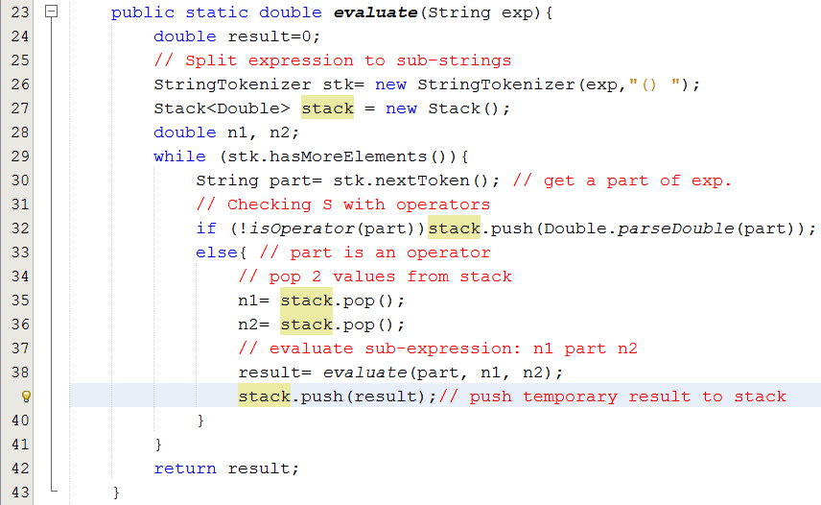
1- Stack: Demo 3...

Slide 22
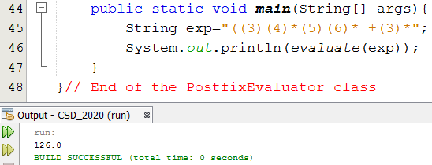
1- Stack: Demo 3.
Evaluating a simple postfix expression.
Do yourself:
Implement a program that will evaluate a prefix expression(Class PrefixEvaluator)
Implement a program for exiting a maze (refer to the textbook)

Slide 23
2- Queues
Where a queue should be used?
A queue should be used when processing order of data is the same as creating order.
Examples:
Printing server: A program receives all printing requirements in a network environment.
Traversing a tree, a graph (next lectures).

Slide 24
2- Queues
A queue is a waiting line that grows by adding elements to its end and shrinks by taking elements from its front
A queue is a structure in which both ends are used:
One for adding new elements
One for removing them
A queue is an FIFO structure: first in/first out
Where a queue should be used?

Slide 25
Queues (continued)
The following operations are needed to properly manage a queue:
clear() — Clear the queue
isEmpty() — Check to see if the queue is empty
enqueue(el) — Put the element el at the end of the queue
dequeue() — Take the first element from the queue
firstEl() — Return the first element in the queue without removing it

Slide 26
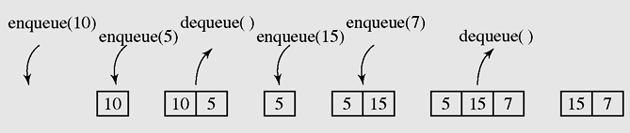
Queues (continued)
Figure 4-8 A series of operations executed on a queue

Slide 27
How to Implementation a Queue
Select a linear storage → array/ linked list
If an array is used: To avoid shift elements when an element is pick out, use circular mechanism for pushing in and picking out an element.
If a linked list is used:
Enqueue: Add to the last
Dequeue: Remove first
Inplement all basic operations:
clear() , isEmpty() , enqueue(el) , dequeue() , firstEl()
The follwing slides will depict queues using a circular array and a linked list as a pool for storing its elements.

Slide 28
How to Implementation a Queue
List | Using array → linear group | Using linked list → linear group
Queue enqueue(x) dequeue() | Add to end → enqueue(x) →O(1) Remove from beginning → dequeue() → Shift up → O(n) → Improvement: circular array → O(1) | Add to the end → O(1) Remove from beginning → O(1)
(1) Use the java.util.LinkedList object as a queue:
Use addFirst(x) and removeLast() only OR addLast(x), removeFirst() only
(2) Use the java.util.ArrayDeque

Slide 29
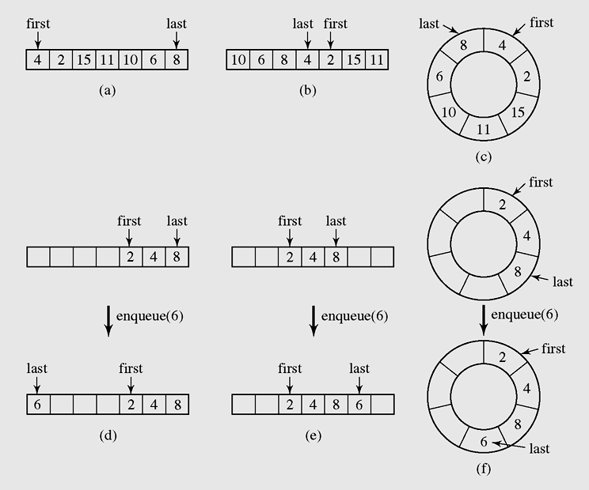
Queues (continued)
If an array is used to store elements of a queue the 2 indexes must be used to mark the beginning and the last positions.
If we do not want to shift elements when an element is pick out the queue then a circular mechanism is used.
➔ What configuration will describe the queue is full?
remove
Add
Circular array
remove
Add
Add
remove
Figure 4-9 Two possible configurations in an array implementation of a queue when the queue is full

Slide 30
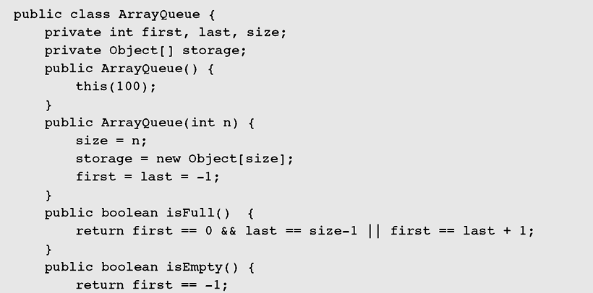

Queues (continued)
Figure 4-10 Array implementation of a queue

Slide 31
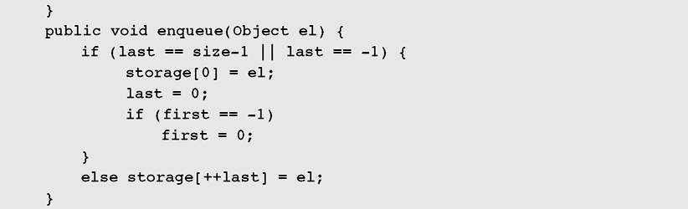
Queues (continued)
The queue is full or empty → Add to the position 0, circular adding
Figure 4-10 Array implementation of a queue (continued)

Slide 32
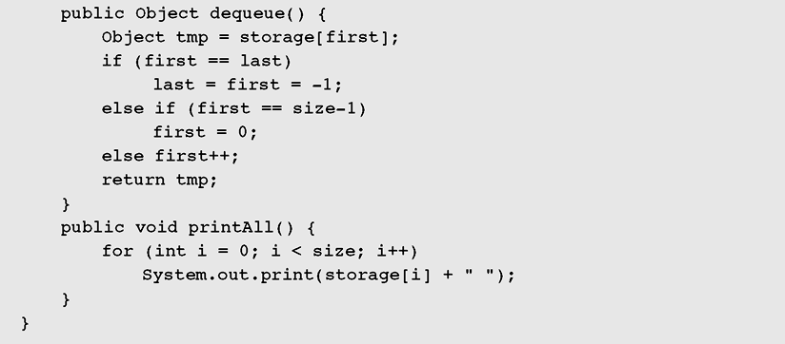
Queues (continued)
In case of only one element
In case of first in the end of array → circular increaseing
Normal case
Figure 4-10 Array implementation of a queue (continued)

Slide 33
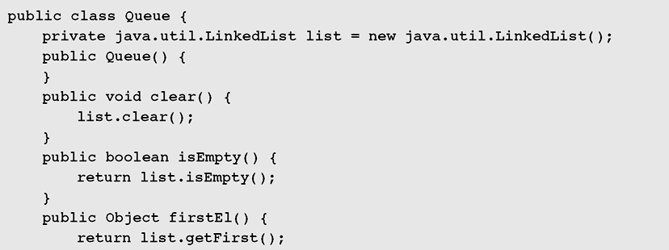
Queues (continued)
Figure 4-11 Linked list implementation of a queue

Slide 34
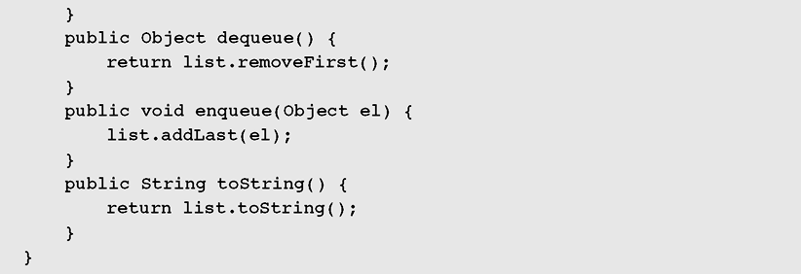
Queues (continued)
Figure 4-11 Linked list implementation of a queue (continued)

Slide 35
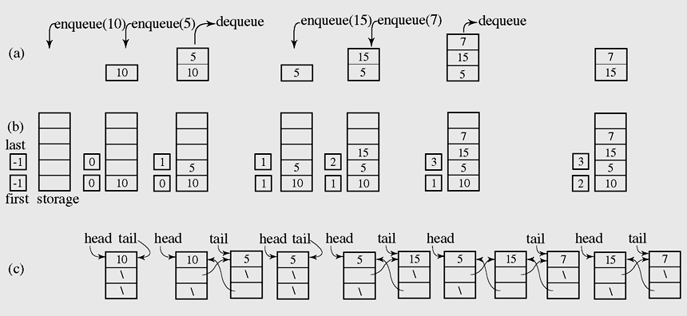
Queues (continued)
Figure 4-12 A series of operations executed on an abstract queue (a) and the stack implemented with an array (b) and with a linked list (c)

Slide 36
Queues (continued)
In queuing theory, various scenarios are analyzed and models are built that use queues for processing requests or other information in a predetermined sequence (order)

Slide 37
3- Priority Queues
Priority: External factor is applied on each data object. It is commonly an integer.
Priority queue is a queue containing priority-assigned objects
When an data object is en-queued, it will be put to a suitable position and the object with highest priority will be de-queued.
Priority queue is viewed as an ordered list.
A priority queue can be assigned to enable a particular process, or event, to be executed out of sequence without affecting overall system operation (operating systems)
In priority queues, elements are de-queued according to their priority and their current queue position.

Slide 38
Priority Queues (continued)
Priority queues can be represented by two variations of linked lists:
All elements are entry ordered based on their priorities.
Order is maintained by putting a new element in its proper position according to its priority ( the enqueue operation must be modified to satisfy this criterion.)

Slide 39
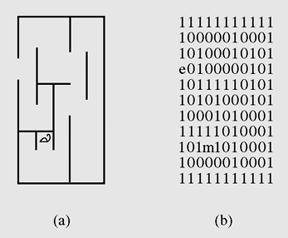
Case Study: Exiting a Maze
1: wall
0: passage
e: exit
m: mouse
Figure 4-15 (a) A mouse in a maze;
(b) two-dimensional character array representing this situation
Ý tưởng: Ô nào đã xét rồi thì đánh dấu để không quay trở lại nữa
Điểm bắt đầu vào stack
Khi chưa tìm thấy lối ra thì
-Đánh dấu diểm này là xét rồi
-Cất các ô có thể đi kề chung quanh ô hiện hành vào stack
-Nếu stack trống → Thất bại
-Ngược lại lấy trong stack ra 1 ô để làm điểm hiện hành
(Code: page 161)

Slide 40
Learning Outcomes
►
LO2.1 Define stack and queue.
LO2.2 List and demonstrate the operations common to stacks and queues.
LO2.3 Describe specific tasks to which stacks and queues are suited.
LO2.4 Apply stacks to a specific application.
LO2.5 Apply queues to a specific application.
LO2.6 Write programs to implement stack and queue in Java programming language.
LO2.7 Define and explain the need of priority queue.
►
►
►
►
►
►

Slide 41
Summary
A stack is a linear data structure that can be accessed at only one of its ends for storing and retrieving data.
A stack is called an LIFO structure: last in/first out.
A queue is a waiting line that grows by adding elements to its end and shrinks by taking elements from its front.
A queue is an FIFO structure: first in/first out.

Slide 42
Summary (continued)
In queuing theory, various scenarios are analyzed and models are built that use queues for processing requests or other information in a predetermined sequence (order).
A priority queue can be assigned to enable a particular process, or event, to be executed out of sequence without affecting overall system operation.

Slide 43
Summary (continued)
In priority queues, elements are dequeued according to their priority and their current queue position.

Slide 44
Review: Stacks and Queues…
LO2.1 Define stack and queue.
They are restricted lists in which add/remove operations are implemented in a specific way in which random accesses are not allowed.
Stacks: Last In First Out lists (LIFO)
Queues: First In First Out lists (FIFO)
LO2.2 List and demonstrate the operations common to stacks and queues.
List | Using array → linear group | Using linked list → linear group
Stack push(x) pop() | Add to end → push(x) → O(1) Remove from end → pop() →O(1) | Add to end → O(1) Remove from end → O(1) OR Add to head → O(1) Remove from head → O(1)
Queue enqueue(x) dequeue() | Add to end → enqueue(x) →O(1) Remove from beginning → dequeue() → Shift up → O(n) → Improvement: circular array → O(1) | Add to the end → O(1) Remove from beginning → O(1)

Slide 45
Review : Stacks and Queues…
LO2.3 Describe specific tasks to which stacks and queues are suited.
A stack is used when some data are processed in opposite order to created order.
Ex: Calculating a postfix expression, reverse printing an integral number, Exiting a maze,…
A queue is used when some data are processed in the same order with created order but processing rate is slower than creating rate.
Ex: A printing server can receive printing requests from some clients but they can not server concurrently and immediately. All waiting requests are stored in a queue.

Slide 46
Review : Stacks and Queues…
LO2.7 Define and explain the need of priority queue.
Priority: External factor is applied on each data object. It is commonly an integer.
Priority queue is a queue containing priority-assigned objects
When an data object is en-queued, it will be put to a suitable position and the object with highest priority will be de-queued.
Priority queue is viewed as an ordered list.

Slide 47
Ôn tập – Viết vào vở
1- Danh sách hạn chế là gì?
2- Stack được gọi là danh sách hạn chế vì lý do gì?
3- Hai tác vụ cơ bản nhất trên stack là gì?
4- Nếu DSLK được dùng để hiện thực stack, hai tác vụ cơ bản trên stack có độ phức tạp thời gian là bao nhiêu?
5- Khi nào stack được khuyên dùng?

Slide 48
Ôn tập – Viết vào vở
6- Queue được gọi là danh sách hạn chế vì lý do gì?
7- Hai tác vụ cơ bản nhất trên queue là gì?
8- Nếu DSLK được dùng để hiện thực queue, hai tác vụ cơ bản trên queue có độ phức tạp thời gian là bao nhiêu?
9- Khi nào queue được khuyên dùng?
10- Với bài toán đổi số hệ 10 sang hệ 2, stack hay queue được khuyên dùng?
11- Sử dụng lớp java.util.LinkedList như là một queue có được không? Tại sao?
12- Hàng đợi ưu tiên được hiện thực bằng gì?

